Slide 1
| PROGRAM SOLVING USING JAVA
INTERCITY BUS
RESERVATION SYSTEM
A Java-based application for managing passenger bookings
BOOK • SEARCH • FILTER • SAVE
Team:
• Eshha Sainni Kalamata | 2620030046
• Chitta Jaya Haasika | 2620080077
Simple records.
Smarter journeys.

Slide 2
ABSTRACT
PROJECT OVERVIEW
The Intercity Bus Reservation System is a menu-driven Java application for storing and managing passenger booking details.
Users can add bookings, view all records, search by Booking ID, filter by destination, and save records to a file.
The project applies Java OOP, exception handling, collections, streams, and file I/O.
PURPOSE
Reduce manual effort and make booking records easier to find and maintain.

Slide 3
UNDERSTANDING THE PROBLEM STATEMENT
PROBLEM - Manual booking records are difficult to search, validate and preserve between program runs.
INPUT → booking ID, passenger name, destination, seats, base fare per seat
PROCESS → validate details • calculate fare • store booking • search/filter records
OUTPUT → confirmation, booking summary, search result or destination-wise list
Core requirements: reject invalid seat counts and empty destinations; save records when exiting.
User workflow: Start → Load saved bookings → Choose menu option → Process request → Save & Exit

Slide 4
CO1 — PROBLEM ANALYSIS & JAVA FUNDAMENTALS
MODULE 1: From problem to program
Scanner reads menu choices and booking details from the console.
String stores IDs, names and destinations; int stores seat count; double stores fare.
Arithmetic expression: totalFare = seats × baseFarePerSeat.
Example: 3 seats × ₹650.00 = ₹1,950.00 (illustrative input).
Program structure: BusReservation class, main() entry point, variables and console output.

Slide 5
CO2 — CONTROL FLOW & VALIDATION
MODULE 2: Selection and iteration
do–while repeats the menu until the user selects Save and Exit (choice 5).
switch selects Book, Display, Search, Filter or Exit operations.
if / else checks whether the booking list is empty and whether results were found.
Control-flow path: Read choice → switch case → execute action → return to menu.

Slide 6
CO3 — METHODS & DATA PROCESSING
MODULE 3: Decomposition, methods and collections traversal
confirmReservation() validates a booking; calculateFare() returns the total fare.
getBookingId(), getPassengerName(), getDestination() and other getters provide access to fields.
Design benefit: small methods separate validation, calculation, display and persistence tasks.

Slide 7
CO4 — OBJECT-ORIENTED PROGRAMMING
MODULE 4: Classes, encapsulation, interfaces and exception handling
BusBooking is a class; each reservation is an object created with a parameterized constructor.
private fields + getters implement encapsulation; toString() formats a booking summary.
confirmReservation() throws InvalidBookingException for seats ≤ 0 or a blank destination.
try–catch handles validation/input errors so the application can report problems instead of stopping

Slide 8
CO5 — STRINGS & FILE INPUT/OUTPUT
MODULE 5: Text processing and persistent storage
toCsvString() joins booking fields into a comma-separated record; split(",") parses records.
trim() cleans entered text; equalsIgnoreCase() compares IDs and destinations without case sensitivity.
compareTo() defines ordering by booking ID through Comparable.
Path and Files.write() save bookings to bus_bookings.txt; Files.newBufferedReader() reloads them.

Slide 9
CO6 — COLLECTIONS, ARRAYLISTS
MODULE 6: Declarative data processing
ArrayList<BusBooking> is a typed collection that stores the current booking objects.
List<BusBooking> keeps multiple booking records together and supports adding new bookings.
forEach(System.out::println) uses a method reference to display each booking.
Stream pipeline: collection → filter → terminal operation (findFirst / collect).

Slide 10
CONCLUSION
The project translates a real-world reservation workflow into a working Java console application.
Modules 1–2 provide input, calculations and menu control; Module 3 supports modular processing.
Module 4 models bookings safely; Module 5 saves and restores records; Module 6 enables search and filtering.
Current limitations: no seat map, schedule availability, user authentication, online payment or live operator data.
Future enhancements: unique-ID checks, stronger CSV validation, cancellation, seat availability and a database-backed interface.

Slide 11
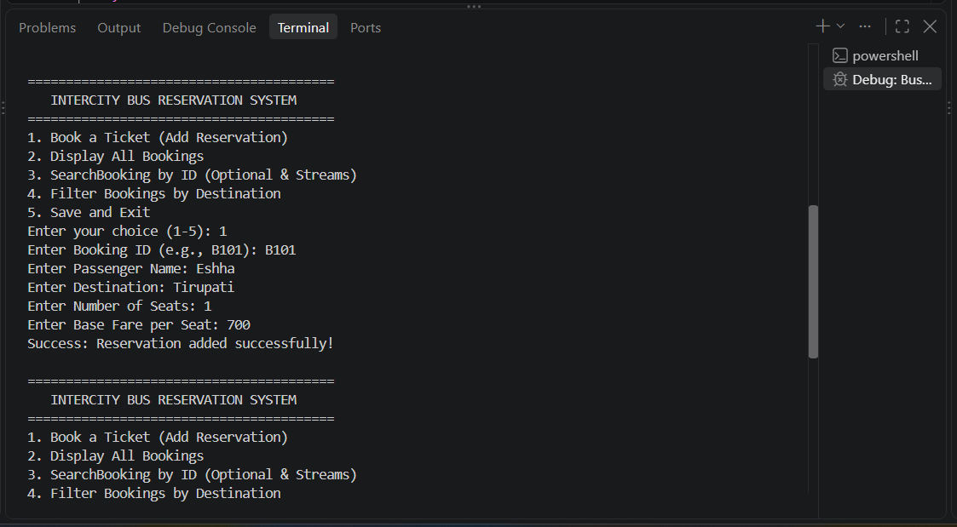
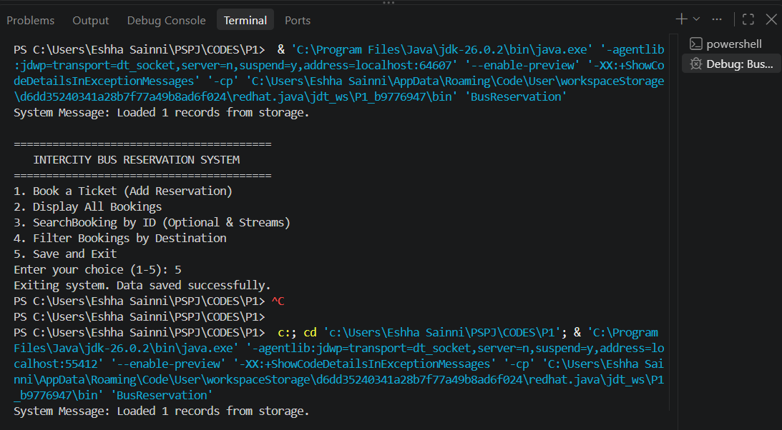
SCREENSHOTS

Slide 12
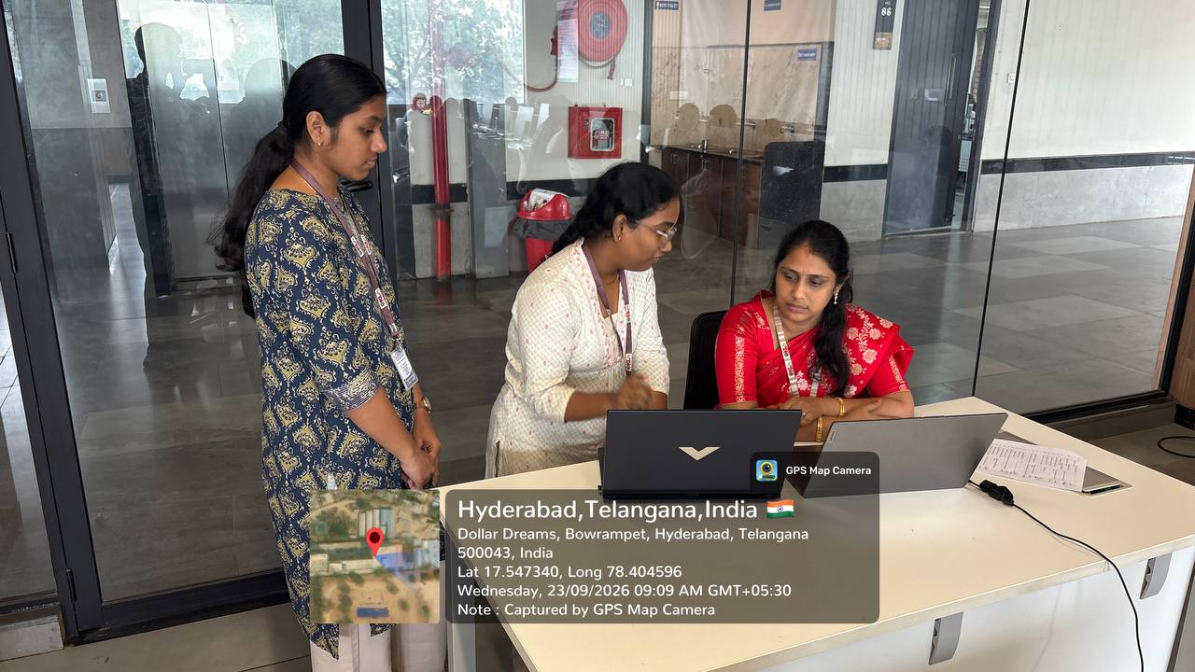
GEOTAG PHOTO AND GITHUB LINKS
2620030046 - https://github.com/eshhasainnikalamata/Y-26-KLH-PSPJ-PROJECT-TEAM-17-Intercity-Bus-Reservation-System
2620080077 - GitHub - jayahaasika1/Y26_PSP_T17 · GitHub

Slide 13
THANK YOU

